Slide 1

Presented By : RAVI SHANKAR (18104108015) MANISHA KUMARI (18104108019) SUMITESH KUMAR (18104108025) PRABHAT PRIYDARSHI (18104108027) Under the esteemed guidance of Dr. Parimal Sah (Department of Electronics and Communication Engineering )
Bhagalpur College Of Engineering
(Dept. Of Electronics and Communication Engineering)
Presentation on
DESIGN AND SIMULATION OF OPTICAL FILTER USING RING RESONATOR IN SILICON-ON-INSULATOR

Slide 2
OUTLINE
Introduction
Design and Simulate the Optical filter usin Ring Resonator in Silicon-On-Insulator in MATLAB.
Design and Simulate the Optical filter using Ring Resonator using Silicon-On-Insulator in Lumerical Suite.
Varying the various input parameters
Result Analysis
Conclusions

Slide 3
The ring resonators are typically used in integrated optics/optoelectronics to obtain functions like wavelength filters/add-drop multiplexers, modulators/switches, delay lines, etc.
Passive optical filters made up of a periodic structure possess a stopband in their transmission spectra.
In this project, we apply a ring resonator consist of waveguide which interacts with a ring through a coupler to implement a optical filter using a silicon-on-insulator (SOI) material system.
INTRODUCTION

Slide 4
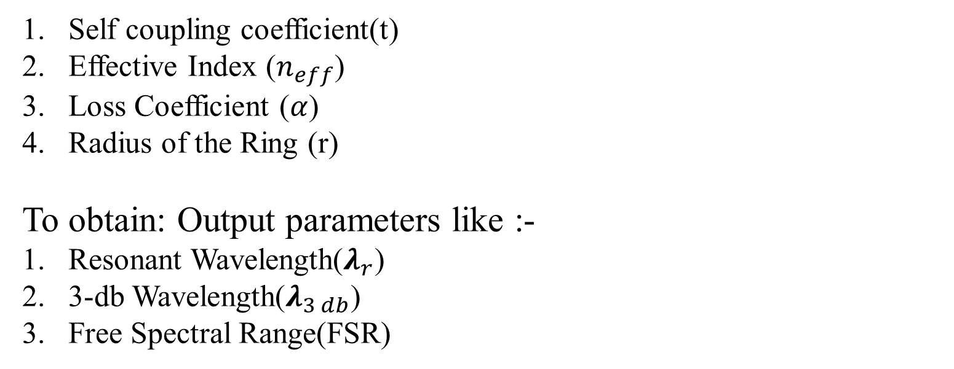
Objective of Project Work
Using MATLAB
To design and simulate the Optical Filter using ring resonator by correspondingly varying the various input parameters like :-
Self coupling coefficient(t)
Effective Index ($n_{eff}$)
Loss Coefficient ($α$)
Radius of the Ring (r)
To obtain: Output parameters like :-
Resonant Wavelength($λ_{r}$)
3-db Wavelength($λ_{3 db}$)
Free Spectral Range(FSR)

Slide 5
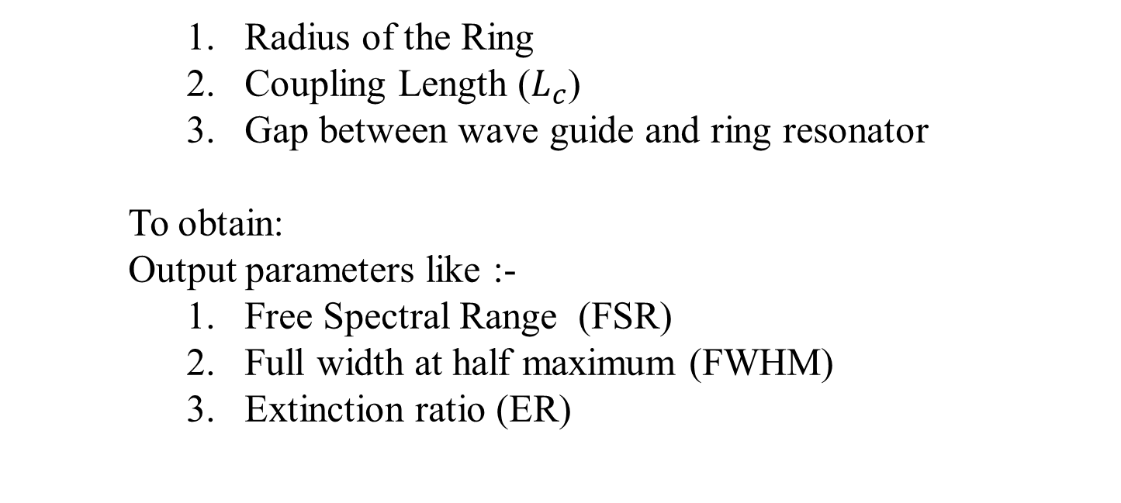
Using Lumerical Suite:-
To design and simulate the Optical Filter using Lumerical Suite in ring resonator by correspondingly varying the various input parameters like :-
Radius of the Ring
Coupling Length ($L_{c}$)
Gap between wave guide and ring resonator
To obtain:
Output parameters like :-
Free Spectral Range (FSR)
Full width at half maximum (FWHM)
Extinction ratio (ER)

Slide 6
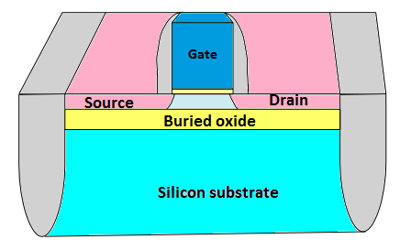
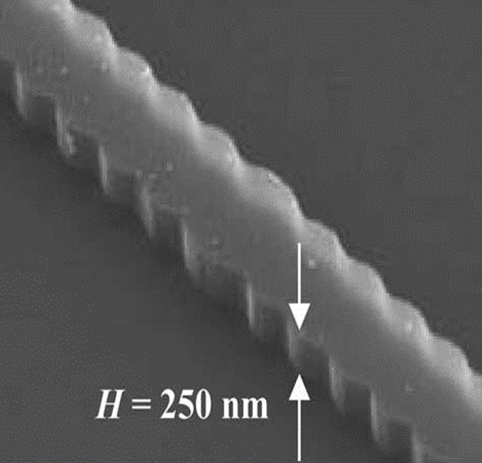
Silicon-On-Insulator(SOI)
SOI is a semiconductor wafer technology that produces higher performing, lower power devices than traditional bulk silicon techniques.
SOI works by placing a thin, insulating layer, such as silicon oxide between a thin layer of silicon and the silicon substrate.
Figure1. Silicon-On-Insulator
Figure2. Fabricated Waveguide

Slide 7
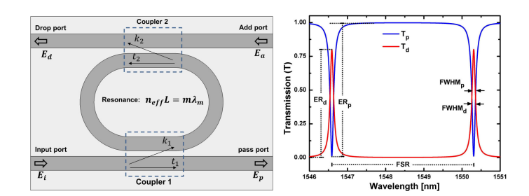
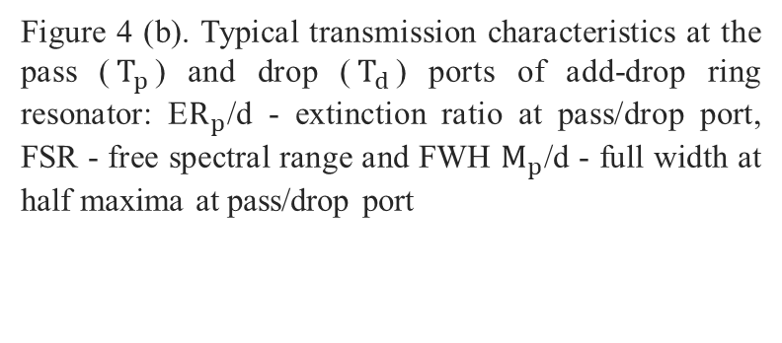
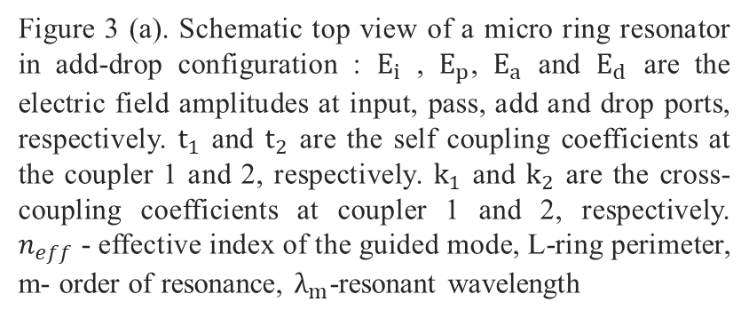
Figure 3 (a). Schematic top view of a micro ring resonator in add-drop configuration : $E_{i}$ , $E_{p}$, $E_{a}$ and $E_{d}$ are the electric field amplitudes at input, pass, add and drop ports, respectively. $t_{1}$ and $t_{2}$ are the self coupling coefficients at the coupler 1 and 2, respectively. $k_{1}$ and $k_{2}$ are the cross-coupling coefficients at coupler 1 and 2, respectively. $n_{eff}$- effective index of the guided mode, L-ring perimeter, m- order of resonance, $λ_{m}$-resonant wavelength
SCHEMATIC DIAGRAM OF RING RESONATOR
Figure 4 (b). Typical transmission characteristics at the pass ($T_{p}$) and drop ($T_{d}$) ports of add-drop ring resonator: E$R_{p}$/d - extinction ratio at pass/drop port, FSR - free spectral range and FWH $M_{p}$/d - full width at half maxima at pass/drop port

Slide 8
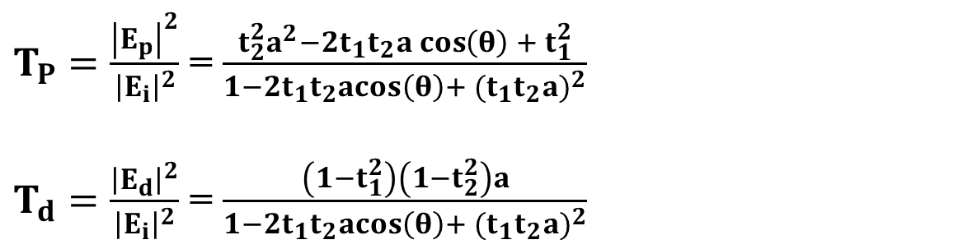
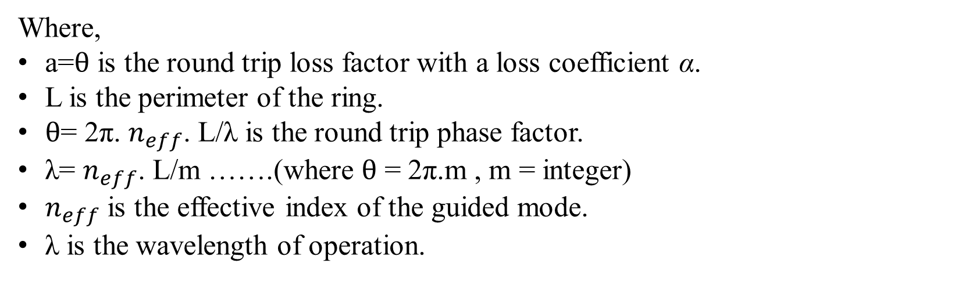
$T_{P}=\frac{{\left|E_{p}\right|}^{2}}{{\left|E_{i}\right|}^{2}}$ = $\frac{t_{2}^{2}a^{2}−2t_{1}t_{2}a\cos\left(θ\right) + t_{1}^{2}}{1−2t_{1}t_{2}acos\left(θ\right)+ {(t_{1}t_{2}a)}^{2}}$
$T_{d}=\frac{{\left|E_{d}\right|}^{2}}{{\left|E_{i}\right|}^{2}}$ = $\frac{\left(1−t_{1}^{2}\right)\left(1−t_{2}^{2}\right)a}{1−2t_{1}t_{2}acos\left(θ\right)+ {(t_{1}t_{2}a)}^{2}}$
eq.(a)
eq.(b)
Where,
a=$θ$ is the round trip loss factor with a loss coefficient α.
L is the perimeter of the ring.
$θ$= 2π. $n_{eff}$. L/λ is the round trip phase factor.
λ= $n_{eff}$. L/m …….(where $θ$ = 2π.m , m = integer)
$n_{eff}$ is the effective index of the guided mode.
λ is the wavelength of operation.

Slide 9
Lumerical Suite
Lumerical Suite is a powerful application which is used for designing and analyzing the photonics.
This software is used for photonics as well as electromagnetism from composite to system stages.
Improved electronic applications which include regulated thermal waveguides, modulators and switch matrices.
Four parts of Lumerical which include FDTD, MODE, INTERCONNECT and DEVICE.
FDTD solves Mathematical equations directly without any physical approximation.
This software is able to inject limited and measured beams with the steady gradients which does not change with frequency.
FDTD solves Mathematical equations directly without any physical approximation.

Slide 10
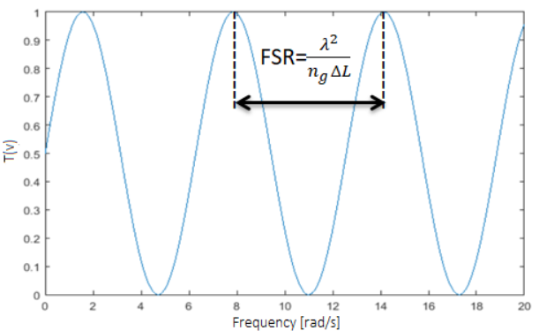
The Finite-Difference Time-Domain (FDTD)
We have extended our work beyond this we have validated all the theoretical result with FDTD simulation.
The Finite-Difference Time-Domain (FDTD) method is a rigorous and powerful tool for modeling nano-scale optical devices.
FDTD solves Mathematical equations directly without any physical approximation, and the maximum problem size is limited only by the extent of the computing power available.
Free Spectral Range (FSR)
The separation between two consecutive resonant wavelength is known as free spectral range (FSR) of the resonator.
Figure 5:Graph Between Frequency Vs Throughput

Slide 11
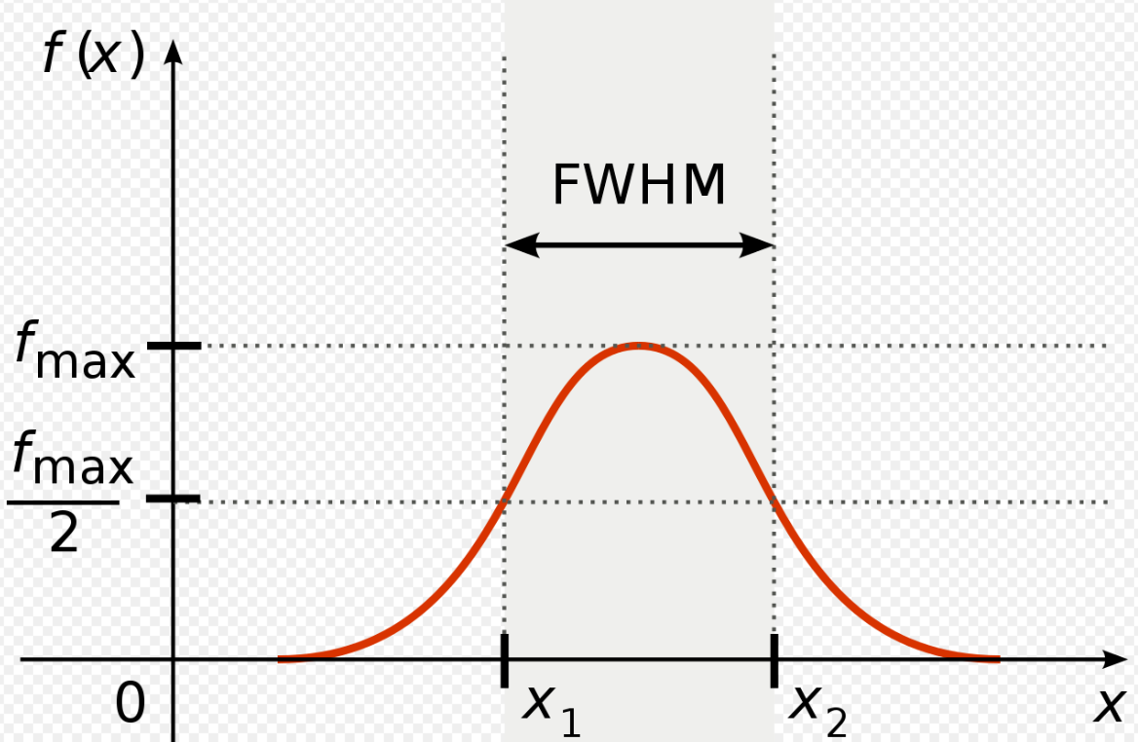
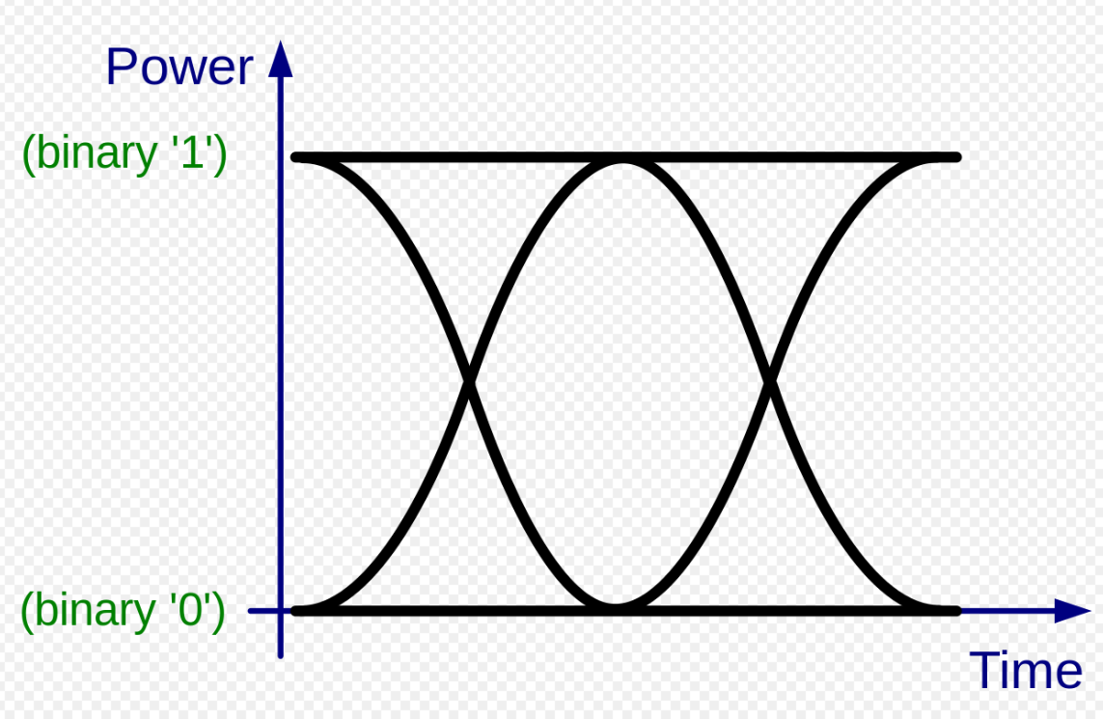
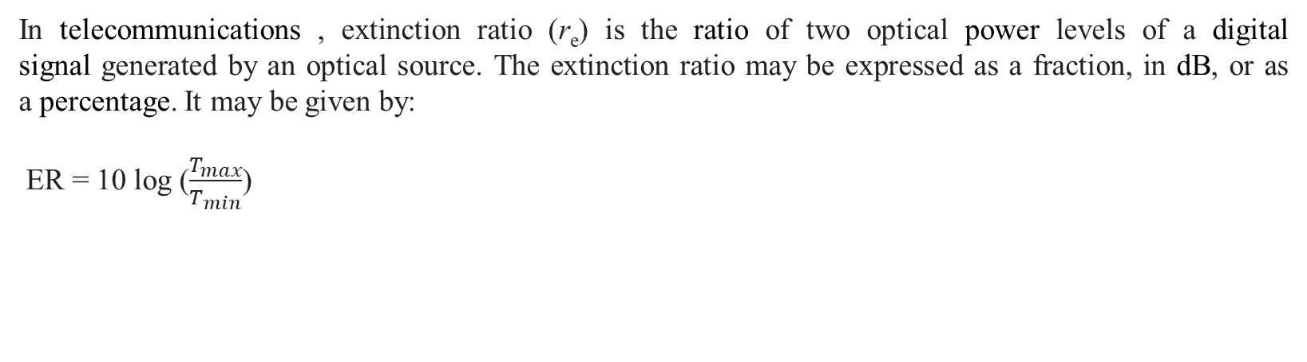
Full width at half maximum (FWHM)
The difference between the two values of the independent variable at which the dependent variable is equal to half of its maximum value.
Figure 6: Graph Of FWHM
Extinction ratio(ER)
In telecommunications , extinction ratio (r_{e}) is the ratio of two optical power levels of a digital signal generated by an optical source. The extinction ratio may be expressed as a fraction, in dB, or as a percentage. It may be given by:
ER = 10 log ($\frac{T_{max}}{T_{min}}$)
Figure 7: Graph Of ER (Power Vs Time)

Slide 12
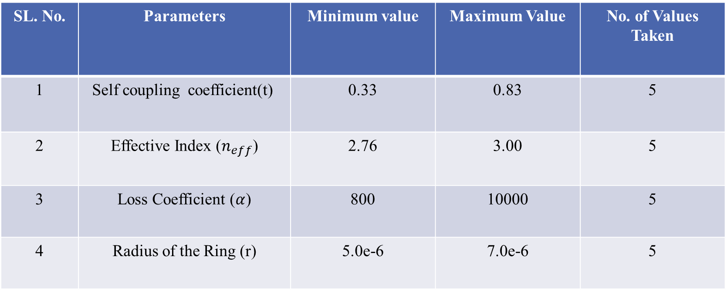
Minimum and Maximum value of each parameter that we varied as:
SL. No. | Parameters | Minimum value | Maximum Value | No. of Values Taken
1 | Self coupling coefficient(t) | 0.33 | 0.83 | 5
2 | Effective Index ($n_{eff}$) | 2.76 | 3.00 | 5
3 | Loss Coefficient ($α$) | 800 | 10000 | 5
4 | Radius of the Ring (r) | 5.0e-6 | 7.0e-6 | 5

Slide 13
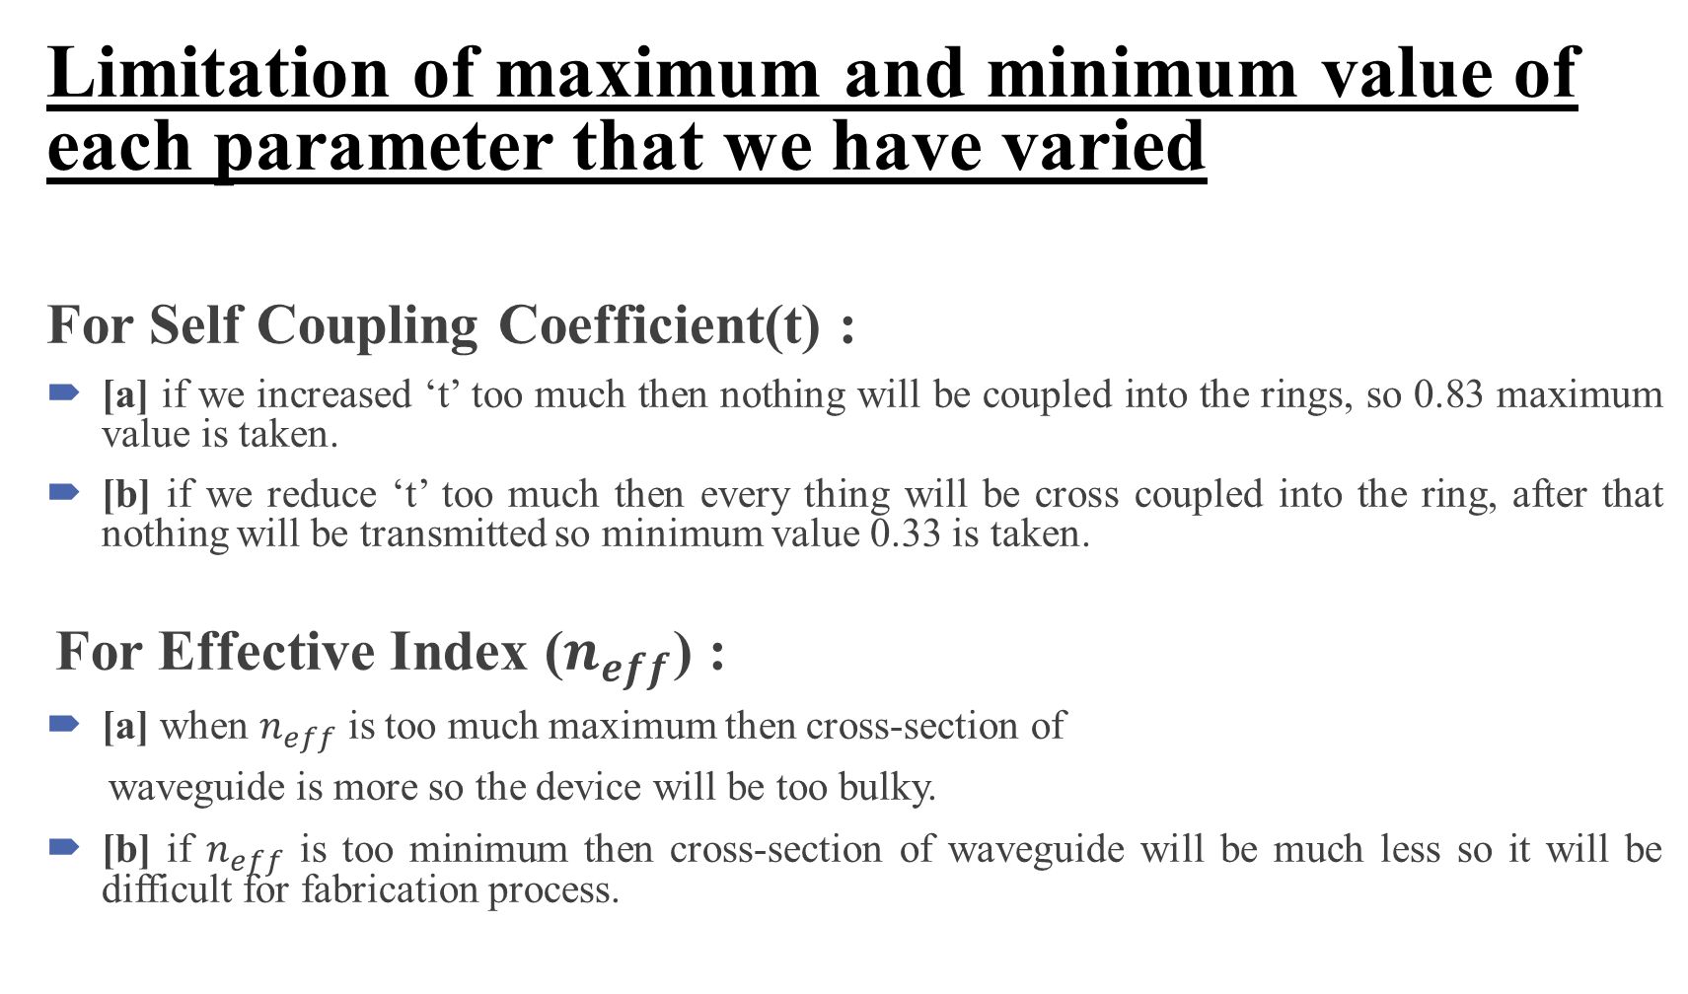
Limitation of maximum and minimum value of each parameter that we have varied
For Self Coupling Coefficient(t) :
[a] if we increased ‘t’ too much then nothing will be coupled into the rings, so 0.83 maximum value is taken.
[b] if we reduce ‘t’ too much then every thing will be cross coupled into the ring, after that nothing will be transmitted so minimum value 0.33 is taken.
For Effective Index ($n_{eff}$) :
[a] when $n_{eff}$ is too much maximum then cross-section of
waveguide is more so the device will be too bulky.
[b] if $n_{eff}$ is too minimum then cross-section of waveguide will be much less so it will be difficult for fabrication process.

Slide 14
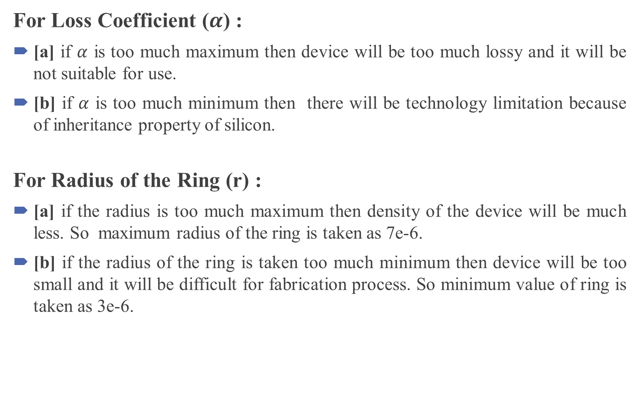
For Loss Coefficient ($α$) :
[a] if $α$ is too much maximum then device will be too much lossy and it will be not suitable for use.
[b] if $α$ is too much minimum then there will be technology limitation because of inheritance property of silicon.
For Radius of the Ring (r) :
[a] if the radius is too much maximum then density of the device will be much less. So maximum radius of the ring is taken as 7e-6.
[b] if the radius of the ring is taken too much minimum then device will be too small and it will be difficult for fabrication process. So minimum value of ring is taken as 3e-6.

Slide 15
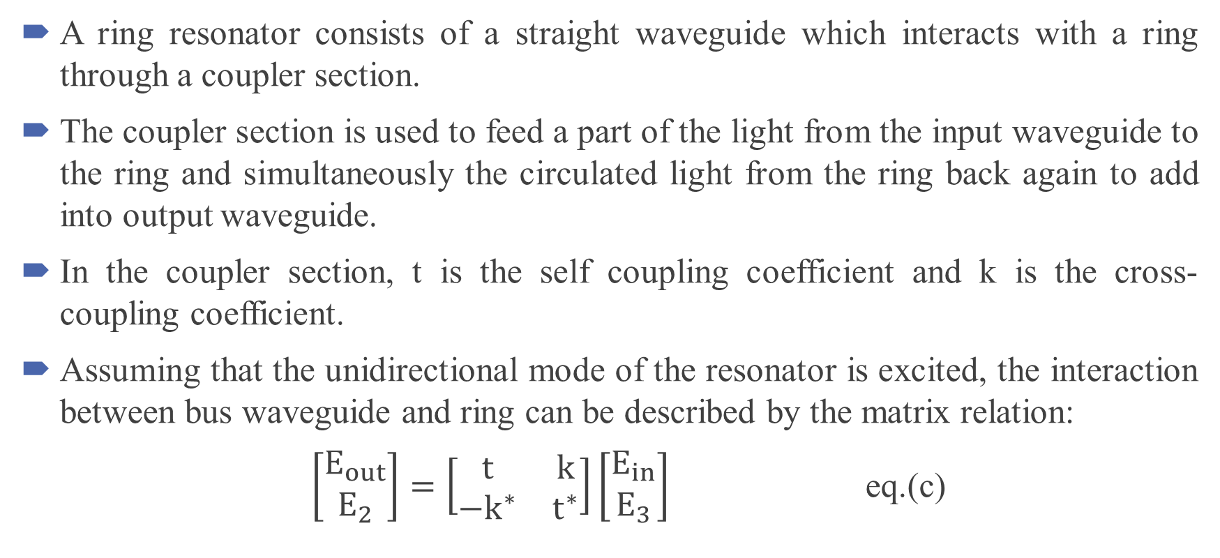
Methodology
A ring resonator consists of a straight waveguide which interacts with a ring through a coupler section.
The coupler section is used to feed a part of the light from the input waveguide to the ring and simultaneously the circulated light from the ring back again to add into output waveguide.
In the coupler section, t is the self coupling coefficient and k is the cross-coupling coefficient.
Assuming that the unidirectional mode of the resonator is excited, the interaction between bus waveguide and ring can be described by the matrix relation:
$\left[\begin{matrix}E_{out} \\ E_{2}\end{matrix}\right]=\left[\begin{matrix}t & k \\ {−k}^{∗} & t^{∗}\end{matrix}\right]\left[\begin{matrix}E_{in} \\ E_{3}\end{matrix}\right]$ eq.(c)

Slide 16
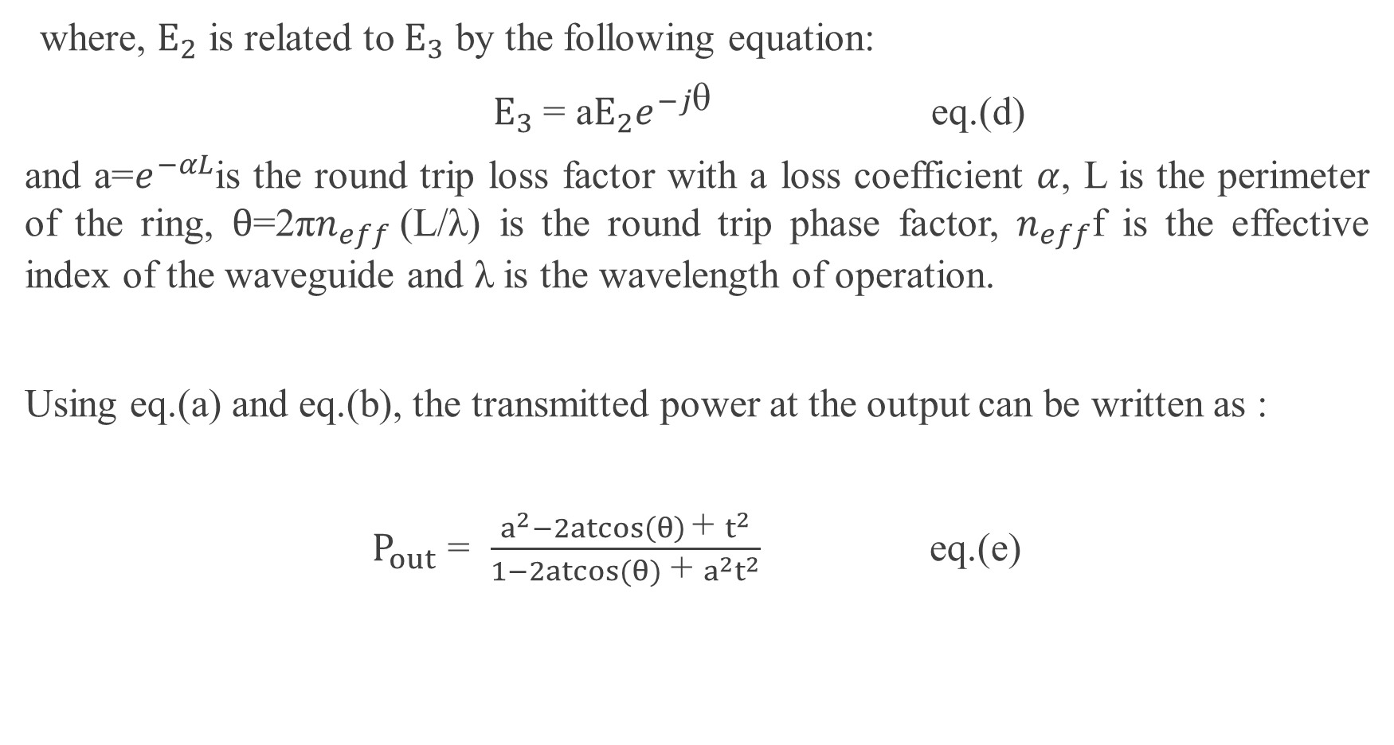
where, $E_{2}$ is related to $E_{3}$ by the following equation:
$E_{3}$= a$E_{2}e^{−j\text{θ}}$ eq.(d)
and a=$e^{−αL}$is the round trip loss factor with a loss coefficient $α$, L is the perimeter of the ring, $θ$=2π$n_{eff}$(L/λ) is the round trip phase factor, $n_{eff}$f is the effective index of the waveguide and λ is the wavelength of operation.
Using eq.(a) and eq.(b), the transmitted power at the output can be written as :
$P_{out}$ = $\frac{a^{2}−2atcos\left(θ\right) \text{+} t^{2}}{1−2atcos(θ) \text{+} a^{2}t^{2}}$ eq.(e)

Slide 17
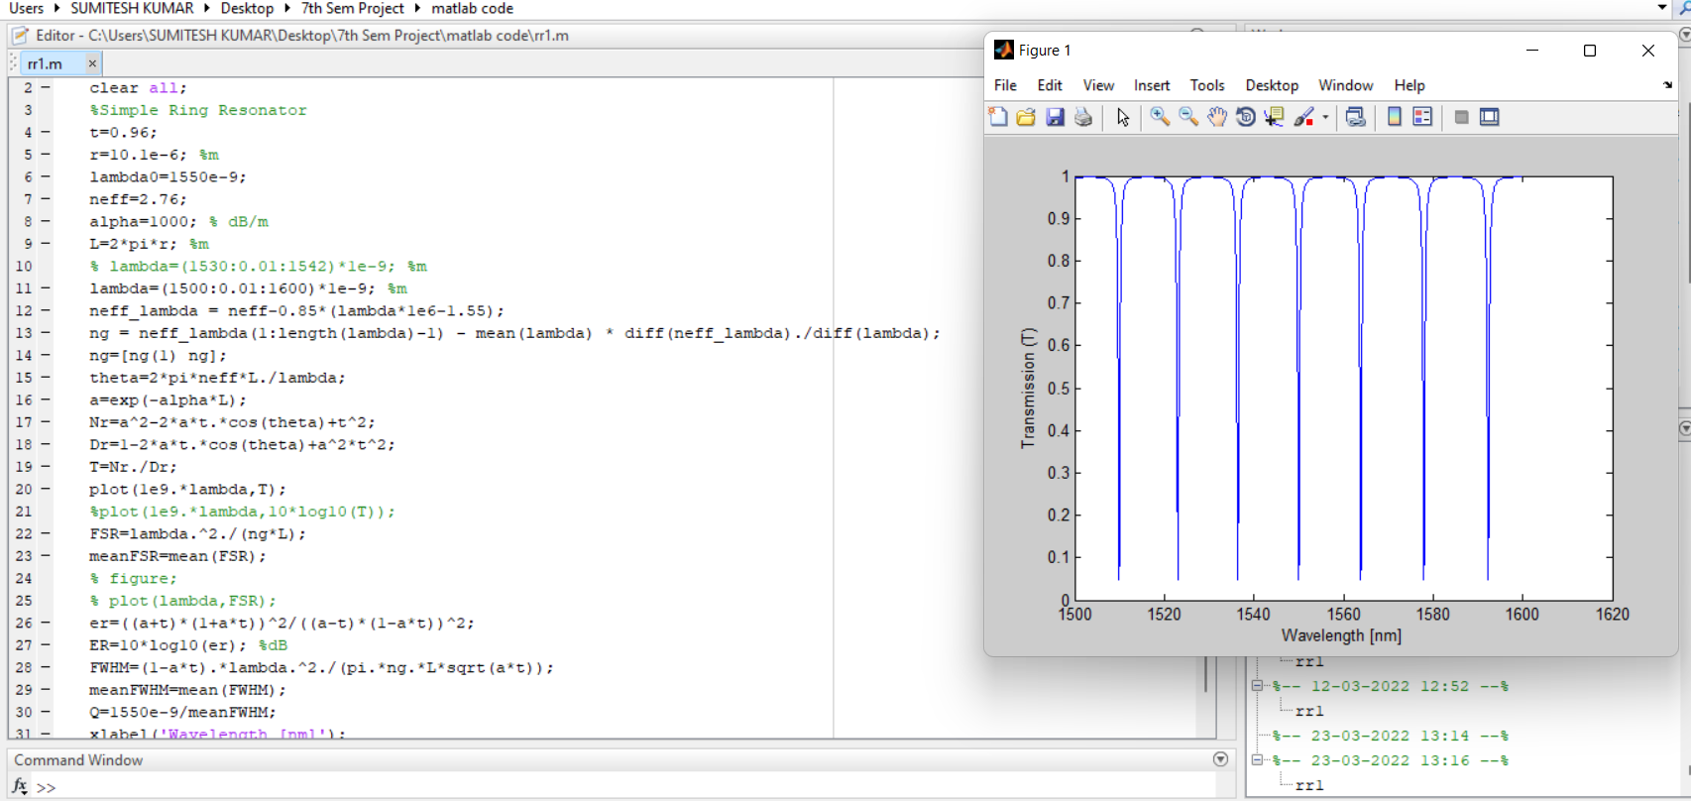
ANALYSIS

Slide 18
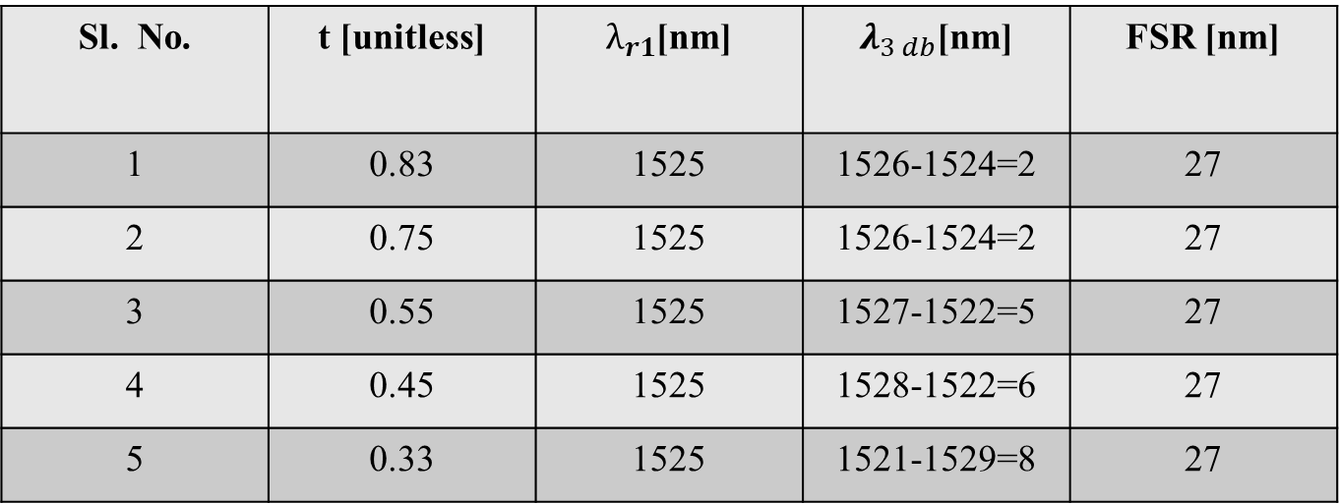
OBSERVATION :
Graphs obtained by variation of input parameters like
CASE 1: When Self coupling coefficient(t) varies -
Sl. No. | t [unitless] | $λ_{r1}$[nm] | $λ_{3 db}$[nm] | FSR [nm]
1 | 0.83 | 1525 | 1526-1524=2 | 27
2 | 0.75 | 1525 | 1526-1524=2 | 27
3 | 0.55 | 1525 | 1527-1522=5 | 27
4 | 0.45 | 1525 | 1528-1522=6 | 27
5 | 0.33 | 1525 | 1521-1529=8 | 27

Slide 19
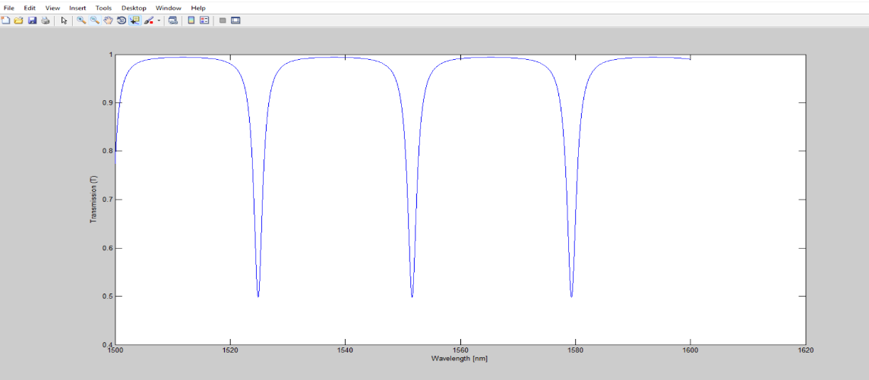
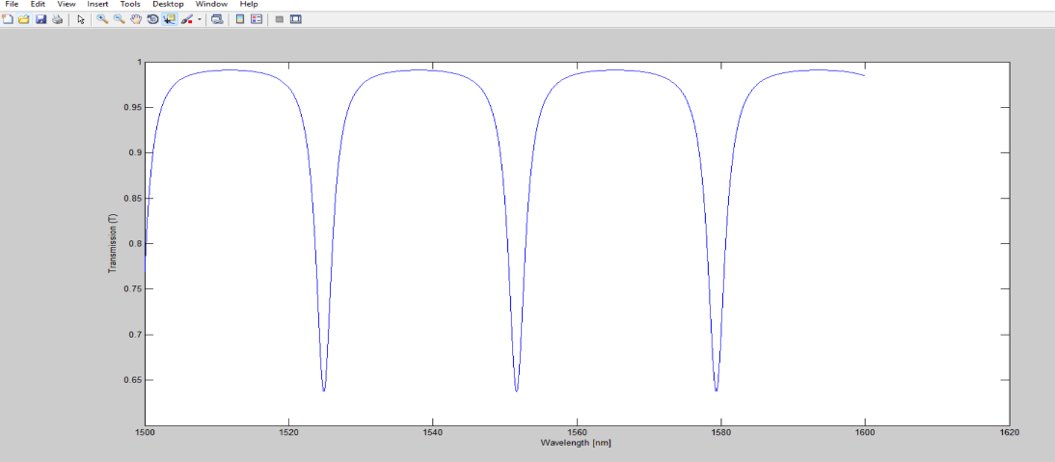
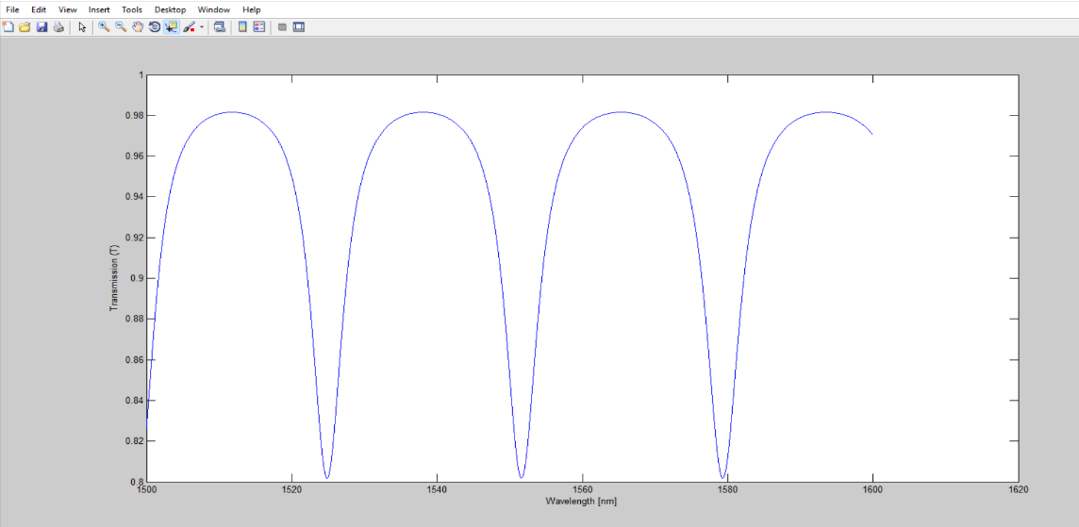
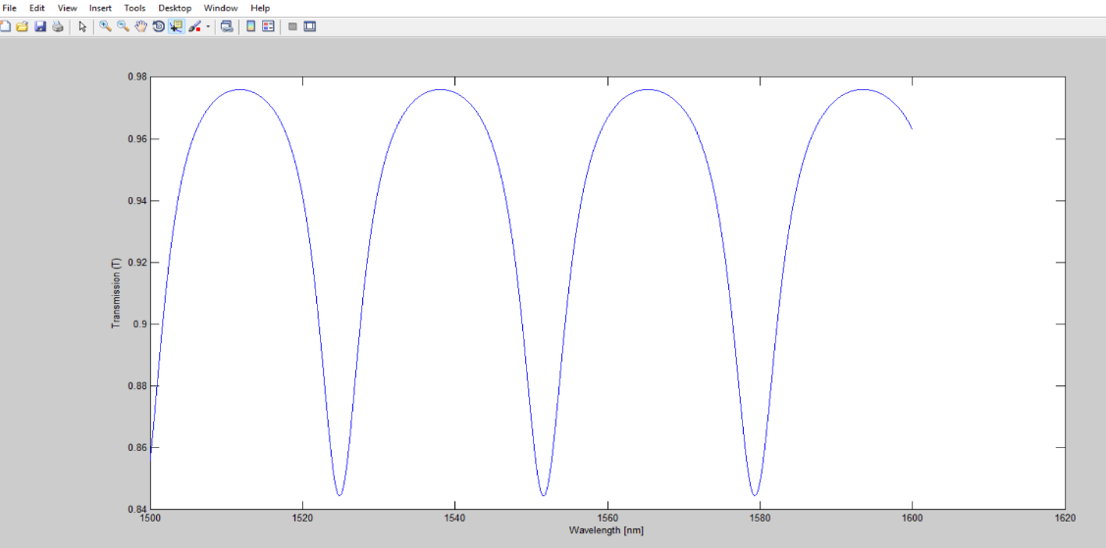
When Self coupling coefficient(t) varies
Figure 8: Bandwidth vs Transmission graph when
t = 0.83
Figure 9: Bandwidth vs Transmission graph when
t = 0.75
Figure 10: Bandwidth vs Transmission graph when
t = 0.83
Figure 11: Bandwidth vs Transmission graph when
t = 0.45

Slide 20
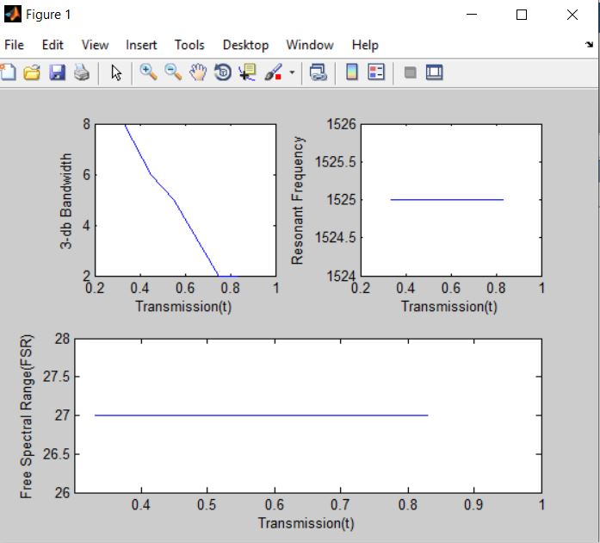
Self coupling coefficient(t) varies with respect to different parameters :
3-db Bandwidth Vs Transmission
Graph is linearly decreasing
Resonant frequency Vs Transmission
Graph is Constant
Free Spectral Range Vs Transmission
Graph is Constant
Figure 12: Self coupling coefficient(t) varies with respect to different parameters

Slide 21
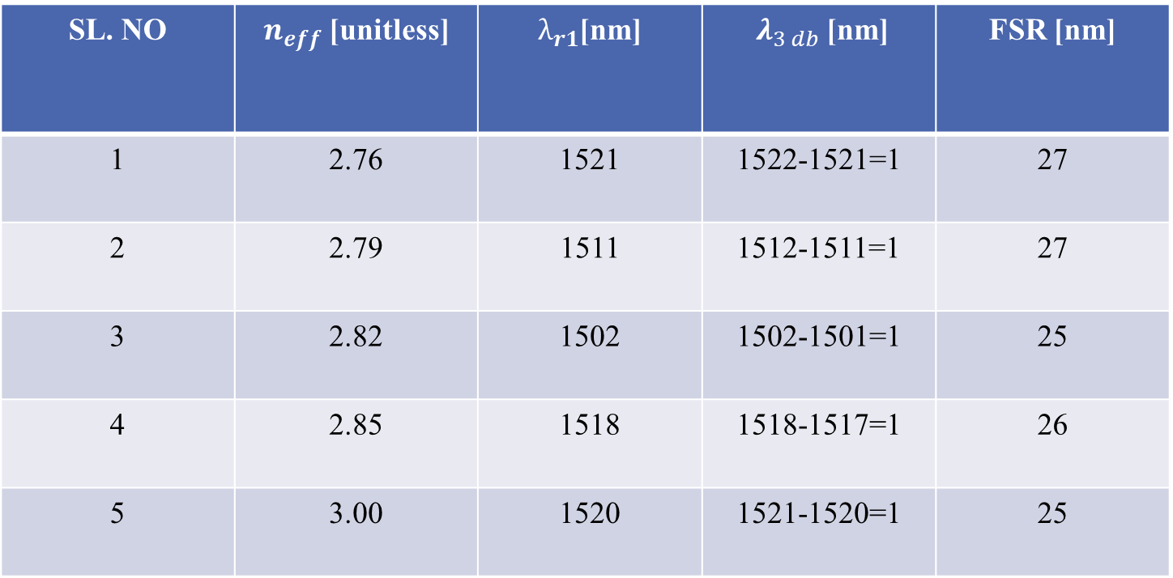
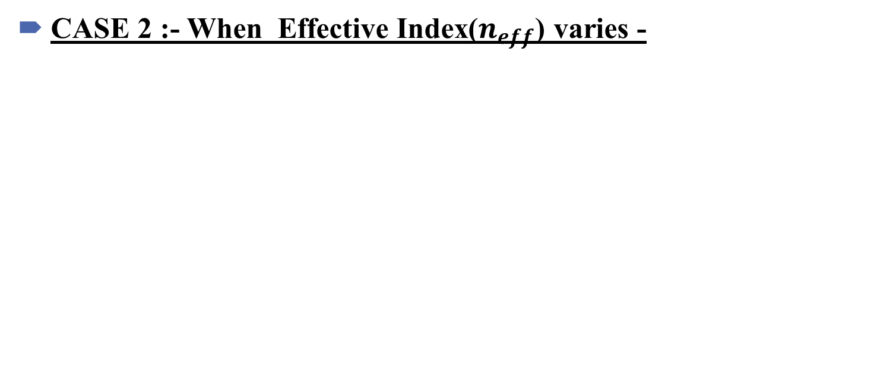
CASE 2 :- When Effective Index($n_{eff}$) varies -
SL. NO | $n_{eff}$ [unitless] | $λ_{r1}$[nm] | $λ_{3 db}$[nm] | FSR [nm]
1 | 2.76 | 1521 | 1522-1521=1 | 27
2 | 2.79 | 1511 | 1512-1511=1 | 27
3 | 2.82 | 1502 | 1502-1501=1 | 25
4 | 2.85 | 1518 | 1518-1517=1 | 26
5 | 3.00 | 1520 | 1521-1520=1 | 25

Slide 22
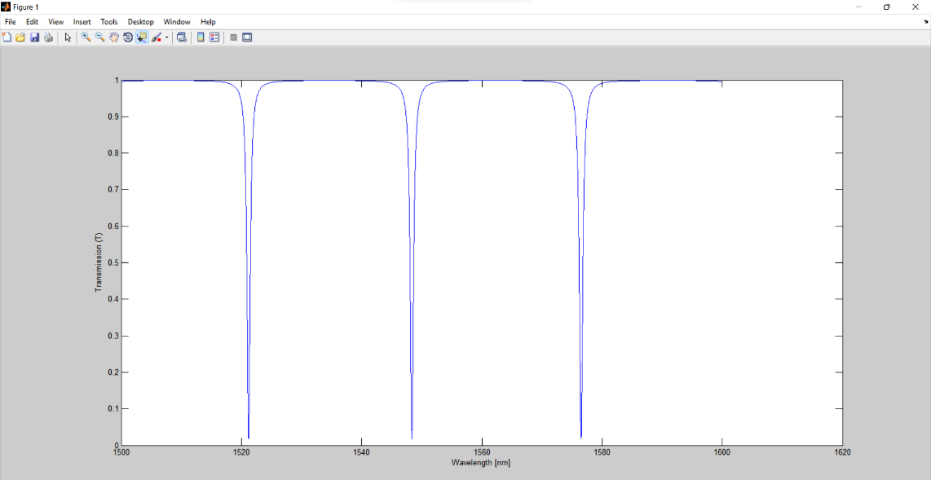
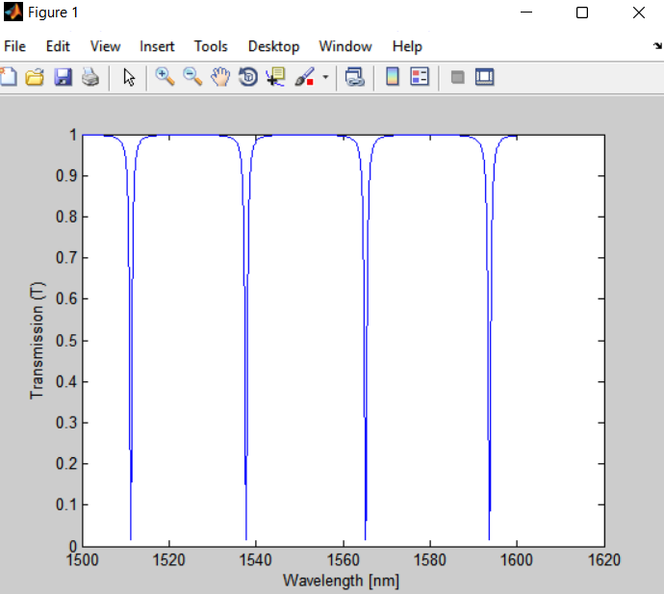
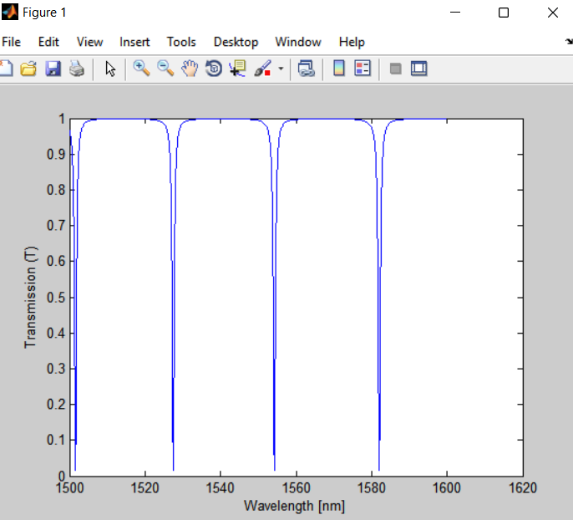
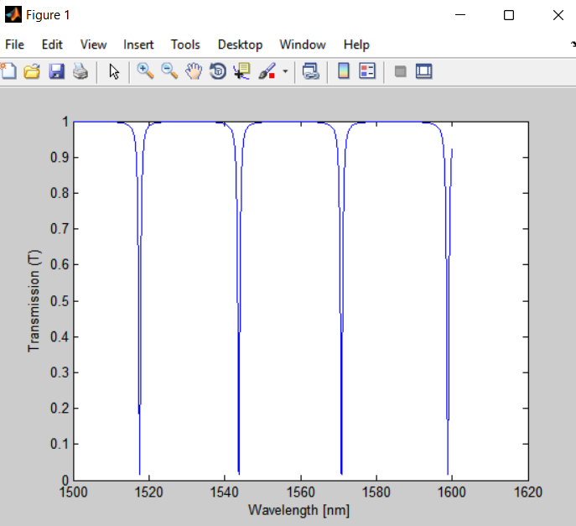
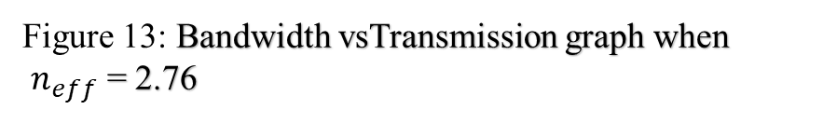

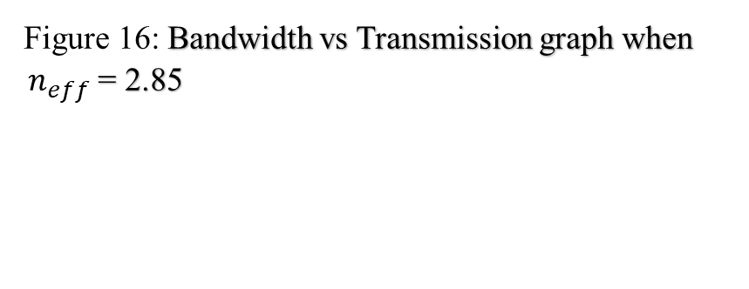
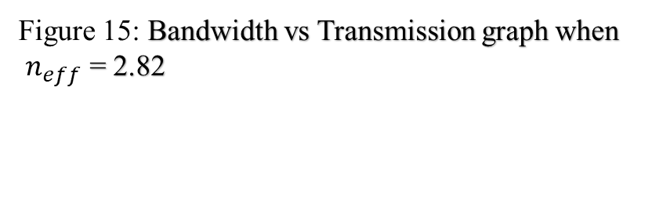
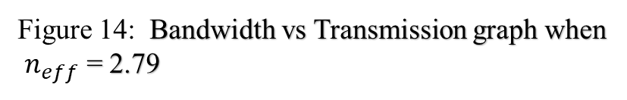
When Effective Index($n_{eff}$) varies
Figure 13: Bandwidth vsTransmission graph when
$n_{eff}$ = 2.76
Figure 14: Bandwidth vs Transmission graph when
$n_{eff}$ = 2.79
Figure 15: Bandwidth vs Transmission graph when
$n_{eff}$ = 2.82
Figure 16: Bandwidth vs Transmission graph when $n_{eff}$ = 2.85

Slide 23
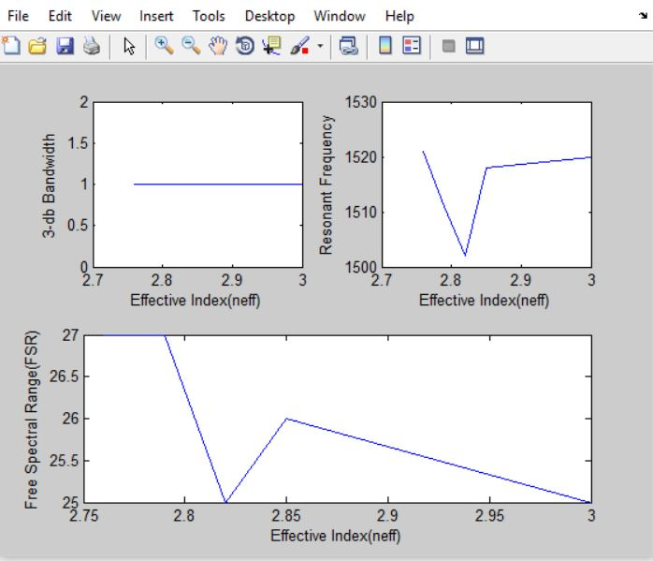
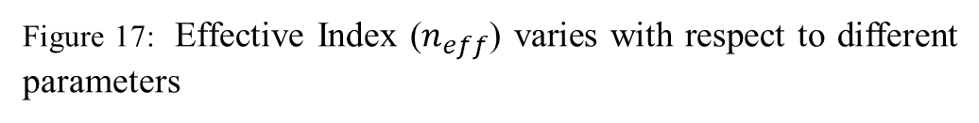
Effective Index ($n_{eff}$) varies with respect to different parameters :
3-db Bandwidth Vs neff
Graph is Constant
Resonant frequency Vs neff
Graph is non-linear
Free Spectral Range Vs neff
Graph is non-linear
Figure 17: Effective Index ($n_{eff}$) varies with respect to different parameters

Slide 24
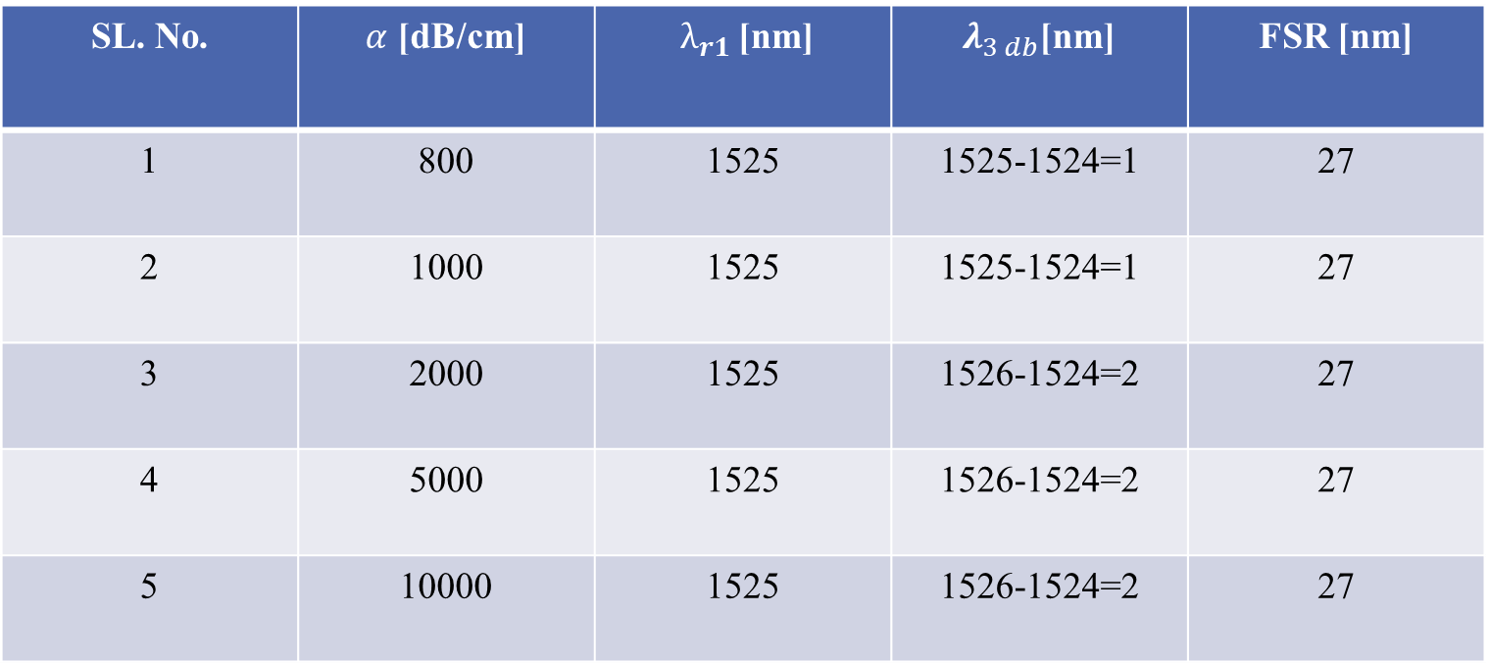
CASE 3: When Loss Coefficient($α$) Varies-
SL. No. | $α$ [dB/cm] | $λ_{r1}$[nm] | $λ_{3 db}$[nm] | FSR [nm]
1 | 800 | 1525 | 1525-1524=1 | 27
2 | 1000 | 1525 | 1525-1524=1 | 27
3 | 2000 | 1525 | 1526-1524=2 | 27
4 | 5000 | 1525 | 1526-1524=2 | 27
5 | 10000 | 1525 | 1526-1524=2 | 27

Slide 25
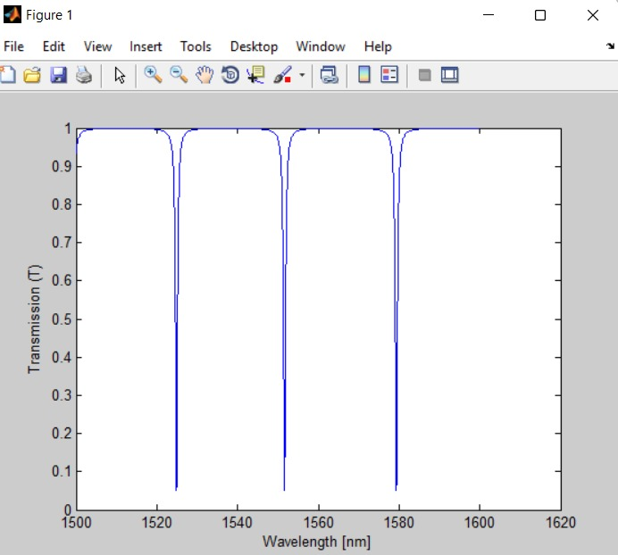
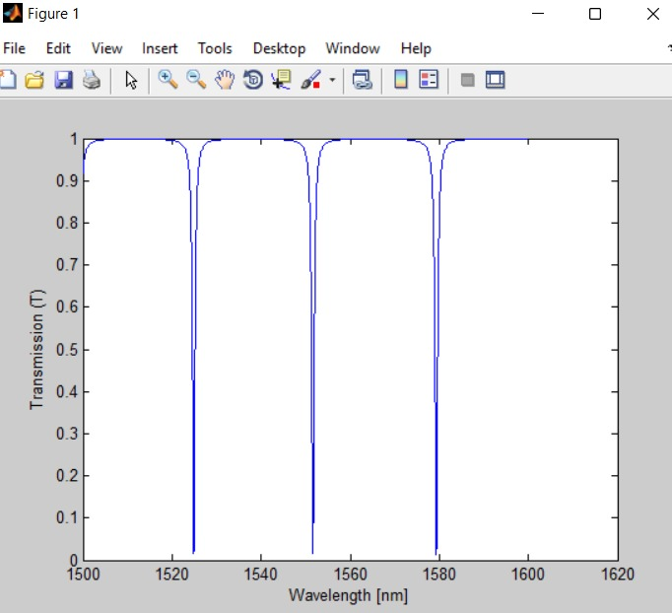
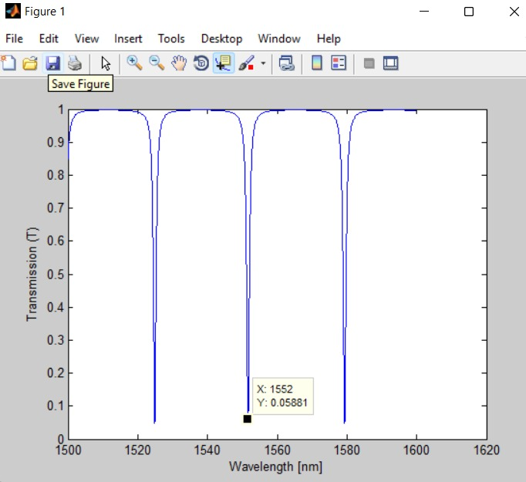
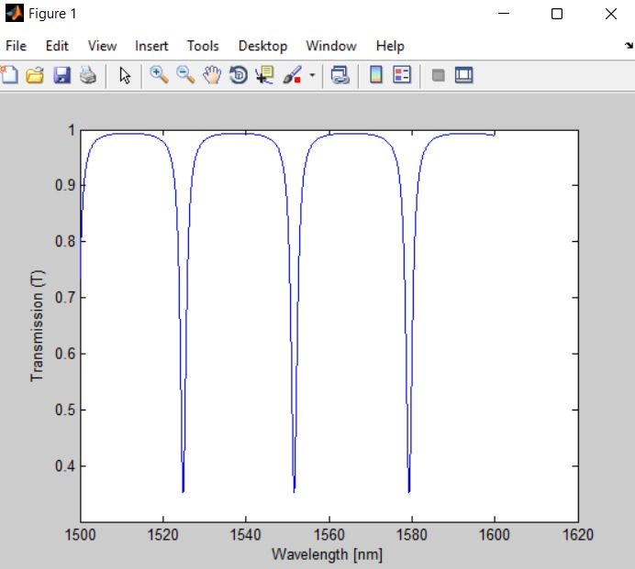
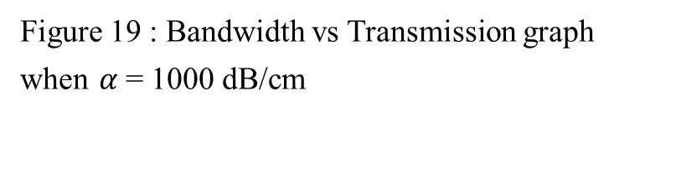
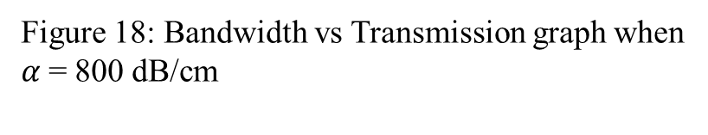
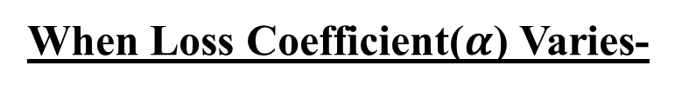
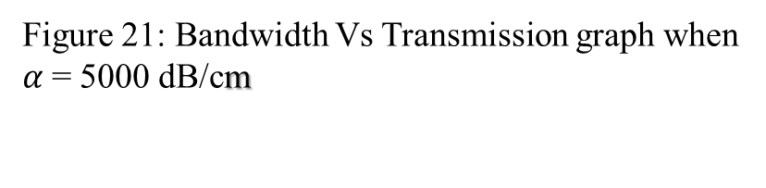
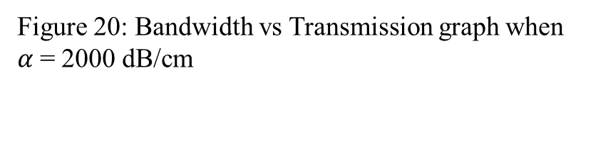
When Loss Coefficient($α$) Varies-
Figure 18: Bandwidth vs Transmission graph when $α$= 800 dB/cm
Figure 19 : Bandwidth vs Transmission graph when $α$= 1000 dB/cm
Figure 20: Bandwidth vs Transmission graph when $α$= 2000 dB/cm
Figure 21: Bandwidth Vs Transmission graph when $α$= 5000 dB/cm

Slide 26
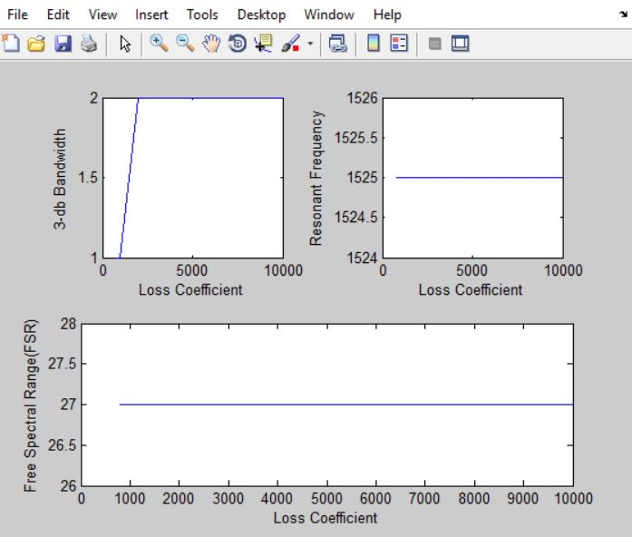
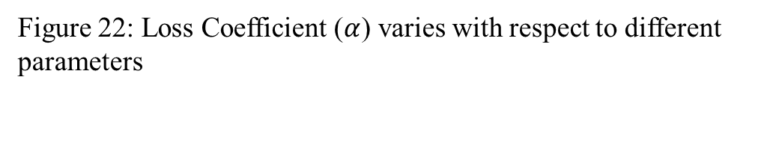
Loss Coefficient ($α$) varies with respect to different parameters :
3-db Bandwidth Vs Loss Coefficient
Graph is linearly increasing
Resonant frequency Vs Loss Coefficient
Graph is Constant
Free Spectral Range Vs Loss Coefficient
Graph is Constant
Figure 22: Loss Coefficient ($α$) varies with respect to different parameters

Slide 27
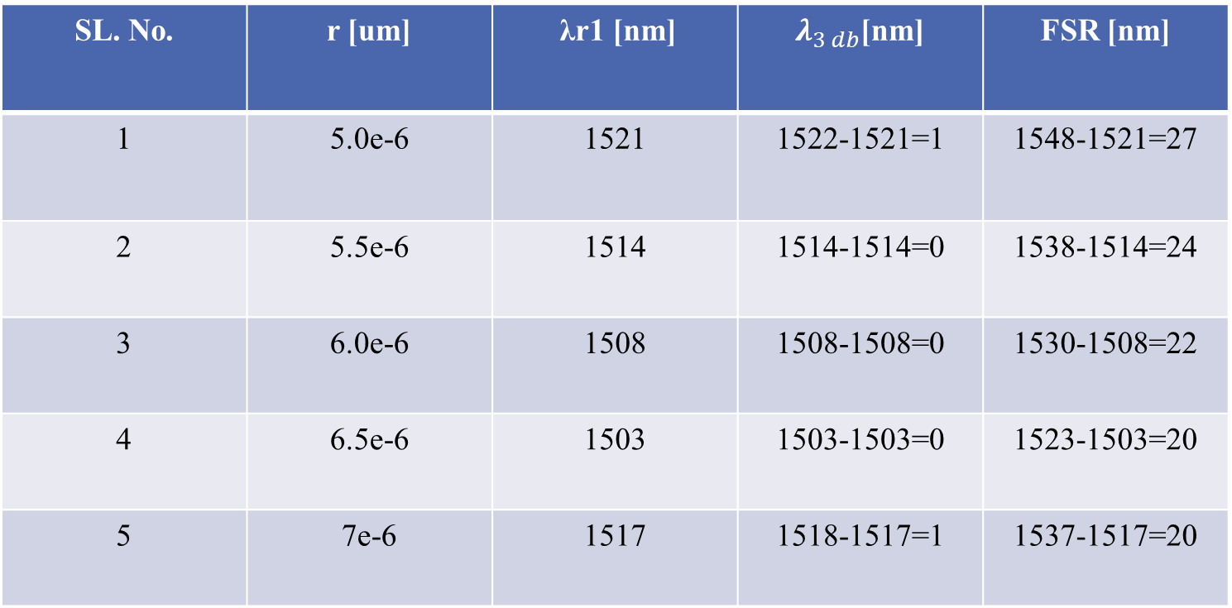
CASE 4: When Radius of the Ring(r) is Varying:
SL. No. | r [um] | λr1 [nm] | $λ_{3 db}$[nm] | FSR [nm]
1 | 5.0e-6 | 1521 | 1522-1521=1 | 1548-1521=27
2 | 5.5e-6 | 1514 | 1514-1514=0 | 1538-1514=24
3 | 6.0e-6 | 1508 | 1508-1508=0 | 1530-1508=22
4 | 6.5e-6 | 1503 | 1503-1503=0 | 1523-1503=20
5 | 7e-6 | 1517 | 1518-1517=1 | 1537-1517=20

Slide 28




When Radius of the Ring(r) is Varying:
Figure 23: Bandwidth vs Transmission graph when r = 5.0e-6
Figure 24: Bandwidth vs Transmission graph when r = 5.5e-6
Figure 25: Bandwidth vs Transmission graph when r = 6.0e-6
Figure 26: Bandwidth vs Transmission graph when r = 6.5e-6

Slide 29

Radius of the Ring (r) varies with respect to different parameters :
3-db Bandwidth Vs Ring Radius
Graph linearly decreases to point 5.5
and starts increases at 6.5
Resonant frequency Vs Ring Radius
Initially Graph decreases at point 6.5
after that it increases linearly
Free Spectral Range Vs Ring Radius
Graph is non linearly decreasing
Fig 27: Radius of the Ring (r) varies with respect to different parameters

Slide 30

Result Analysis After Simulation using Lumerical Suit:-

Slide 31
Table for Designing a Model:
Material | Dimensions
Rectangular Slab (SiO₂ material) | X-span=30μm, Y-span=20μm, Z-Span=4μ, Centre=0
Rectangular Slab (Si material) | 150nm.
Ring (Si material) | Inner radius=5μm, Outer radius=5.5μm
Bus1, Bus2, Bus3, Bus4 Waveguide respectively (Si material) | 5.85μm, 5.65μm, 5μm, 5μm as centre respectively
Monitor | 5.85μm as centre

Slide 32
When radius Of Ring is Varying:-
Radius(μm) (Outer radius – Inner radius) | FSR(μm) | FWHM(μm) | ER
5.175 – 4.725 | 1555-1530=25 | 1507-1504=3 | 10log(0.98/0.78)=1.003
5.275- 4.625 | 1536-1512=24 | 1513-1511=2 | 10log(0.98/0.27)=5.56
5.375-4.525 | 1547-1523=24 | 1520-1526=6 | 10log(0.8/.009)=9.48

Slide 33

Output Obtained after taking different radius value of Ring Resonator:-
Figure 28: Graph Between Lambda Vs P_through

Slide 34



Free Spectral Range (FSR) Vs Radius
When we increase radius of ring resonator then FSR is constant.
Figure 29:FSR Vs Radius graph
Full width at half maximum (FWHM) Vs Radius
When we increase radius of ring resonator then FWHM is first decrease and then increase.
Figure 30: FWHM Vs Radius graph
Extinction ratio (ER) Vs Radius
When we increase radius of ring resonator then ER is increasing linearly.
Figure 31: ER Vs Radius Graph

Slide 35
Table Obtained after taking different Coupling Length (Lc) of Ring Resonator :-
Coupling Length(Lc) (μm) | FSR(μm) | FWHM(μm) | ER
1 | 1541-1519=22 | 1521-1518=3 | 10log(0.95/0.03)=15
1.5 | 1558-1536=22 | 1537-1535=2 | 10log(1.0/0.45)=3.46
2 | 1531-1511=20 | 1514-1508=6 | 10log(0.82/0.22)=5.713

Slide 36



Taking different Coupling Length (Lc) of Ring Resonator
Figure 32 : Coupling Length(Lc) 1 (μm)
Figure 33 : Coupling Length(Lc)
1.5(μm)
Figure 34 : Coupling Length(Lc)
2 (μm)

Slide 37

Output Obtained after taking different Coupling Length(Lc) of Ring Resonator:-
Figure 35: Graph Between Lambda(microns) Vs P_through

Slide 38



Free Spectral Range (FSR) Vs Coupling Length(Lc)
When we increase Coupling Length(Lc) of ring resonator then FSR is decreasing.
Figure 36:FSR Vs Lc graph
Full width at half maximum (FWHM) Vs Coupling Length (Lc)
When we increase of ring resonator then FWHM is Coupling Length(Lc) first decreasing and then increasing linearly.
Figure 37: FWHM Vs Lc graph
Extinction ratio (ER) Vs Coupling Length (Lc)
When we increase Coupling Length(Lc) of ring resonator then ER is first decreasing and then increasing linearly.
Figure 38: ER Vs Lc graph

Slide 39
Table Obtained after taking different Gap between waveguide and ring resonator (μm)
Gap between waveguide and ring resonator (μm) | FSR(μm) | FWHM(μm) | ER
0.01 | 1552-1529=23 | 1530-1527=3 | 10log(0.97/0.35)=5.713
0.05 | 1552-1528=24 | 1529-1528=1 | 10log(0.98/0.44)=3.48
0.08 | 1552-1528=26 | 1553-1551=2 | 10log(0.99/0.51)=2.88

Slide 40

Output Obtained after taking different Gap between waveguide of Ring Resonator:-
Figure 39: Graph Between Lambda(microns) Vs P_through

Slide 41



Free Spectral Range (FSR) Vs Gap between waveguide and ring resonator
When we increase Gap between waveguide and ring resonator of ring resonator then FSR is decreasing.
Figure 40: FSR Vs Gap Graph
Full width at half maximum (FWHM) Vs Gap between waveguide and ring resonator
When we increase Gap between waveguide and ring resonator of ring resonator then FWHM is first decreasing and then increasing after certain point.
Figure 41: FWHM vs Gap Graph
Extinction ratio (ER) Vs Gap between waveguide and ring resonator
When we increase Gap between waveguide and ring resonator then ER is decreasing.
Figure 42: ER vs Gap Graph

Slide 42

APPLICATIONS
used as filter where one can transmit or receives particular frequency or range of frequency.
temperature sensitive devices.
Used in medical sciences like to detect cancer cells in the body , different blood samples.
used as multiplexer and demultiplexer in communication system.
useful as single photon sources for quantum information experiments.
Biological sensors as a bio analytic tools.

Slide 43

SUMMARY
Working of Optical Filter Using Ring Resonator in Silicon-On-Insulator with the help of MATLAB
Variation of Several Parameters like :
1. Self coupling coefficient(t)
2. Effective Index ($n_{eff}$)
3. Loss Coefficient ($α$)
4. Radius of the Ring (r)
Working of Optical Filter Using Ring Resonator in Silicon-On-Insulator with the help of Lumerical Suite .
Variation of Several Parameters like :
Radius of the Ring
Coupling Length (Lc)
Gap between wave guide and ring resonator
# Results were obtained and graph plotted between transmission Vs wavelength
# Results were obtained and graph plotted between Output parameters Vs varying the various input parameters.

Slide 44
THANK YOU

